Slide 1
Chapter 19
Building a Better Window with System.Windows.Forms

Slide 2
Objectives
The process of building traditional form-based desktop applications
How to build a main window using the Form and Application class
How to capture and respond to user input
Learn to construct menu systems, toolbars, status bars and MDI applications

Slide 3
Content
Overview of the System.Windows.Forms namespace
The role of the Application class
Forms and Controls
Working with MenuStrips and ContextMenuStrips
Working with StatusStrips
Working with ToolStrips
Building an MDI Application

Slide 4
Overview of the System.Windows.Forms namespace
Core infrastructure
  the core operations of a .NET Forms program (Form, Application, etc.)
  various types to facilitate interoperability with legacy ActiveX controls.
Controls
  used to create rich Uis ((Button, MenuStrip, ProgressBar, DataGridView, etc.)
  derive from the Control base class
  are configurable at design time and are visible (by default) at runtime.

Slide 5
Overview of the System.Windows.Forms namespace
Components
  do not derive from the Control base class but still provide visual features to a .NET Forms program (ToolTip, ErrorProvider…)
  Many components are not visible at runtime, but can be configured visually at design time. (Timer..)
Common dialog boxes (OpenFileDialog, PrintDialog, etc)
Notes:
Visual feature: ToolTip, ErrorProvider

Slide 6
The role of the Application class
Defines numerous static members to control various low-level behaviors of a Windows Forms application
DoEvents(): Provides the ability for an application to process messages currently in the message queue during a lengthy operation
Exit(): Terminates the Windows application and unloads the hosting AppDomain
EnableVisualStyles(): Configures your application to support Windows XP visual styles

Slide 7
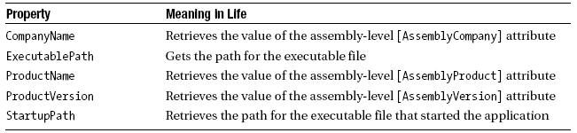
The role of the Application class
Core properties of the Application type
ApplicationExit: Occurs when the application is just about to shut down
Idle: Occurs when the application’s message loop has finished processing the current batch of messages and is about to enter an idle state (as there are no messages to process at the current time)
ThreadExit: Occurs when a thread in the application is about to terminate

Slide 8
Forms and Controls
A form is a visual surface to display information to the user
A control is a discrete user interface (UI) element that displays data or accepts data input

Slide 9
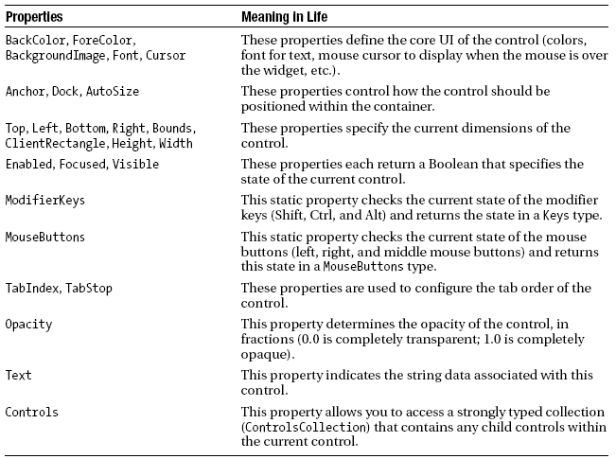
The functionality of the Control class
Core properties of the Control type

Slide 10
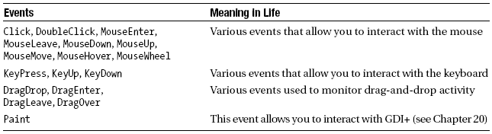
The functionality of the Control class
Events of the Control type

Slide 11
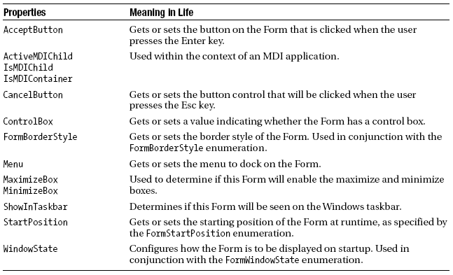
The functionality of the Form class
The Form class is typically the direct base class for custom Form types
Inherited from the Control, ScrollableControl, and ContainerControl classes
Properties of the Form type

Slide 12
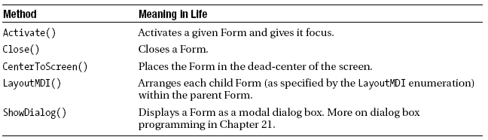
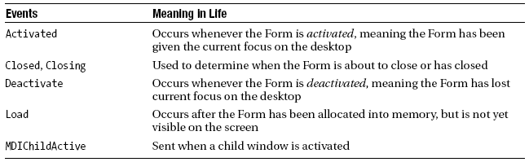
The functionality of the Form class
Key methods of the Form type
Select events of the Form type

Slide 13
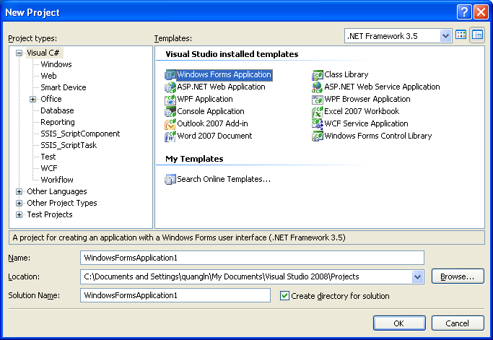
Building Windows Applications with Visual
Studio 2008
The Visual Studio 2008 Windows Application project

Slide 14
Working with MenuStrips and ContextMenuStrips
Common UI elements that may be contained within a MenuStrip:
  ToolStripMenuItem: A traditional menu item
  ToolStripComboBox: An embedded ComboBox
  ToolStripSeparator: A simple line that separates content
  ToolStripTextBox: An embedded TextBox

Slide 15
Working with StatusStrips
Is typically mounted at the bottom of the Form
May be divided into any number of “panes” that hold some textual (or graphical) information such as menu help strings, the current time, or other application specific information

Slide 16
Working with StatusStrips
Kind of tool strip items:
  ToolStripProgressBar: An embedded progress bar
  ToolStripDropDownButton: An embedded button that displays a drop-down list of choices when clicked
  ToolStripSplitButton:
    similar to the ToolStripDropDownButton
    the items of the drop-down list are displayed only if the user clicks directly on the drop-down area of the control
    has normal buttonlike behavior and can support the Click event.

Slide 17
Working with ToolStrips
ToolStripButton
ToolStripLabel
ToolStripSplitButton
Working with ToolStripContainers
Example: ToolStripApp

Slide 18
Building an MDI Application
MDI applications allow users to have multiple child windows open at the same time within the same topmost window
In the world of MDIs, each window represents a given “document” of the application
Given that Forms are class types, any private data defined in the child Form will be unique to a particular instance

Slide 19
Summary
Introduce the fine art of building a UI with the types contained in the System.Windows.Forms namespace
How to build topmost and pop-up menus
How to respond to a number of menu events
How to construct MDI applications using Windows Forms

Slide 20
Q & A

